Slide 1
L5 Planning
Zonghua Gu, Umeå University
Nov. 2023

Slide 2
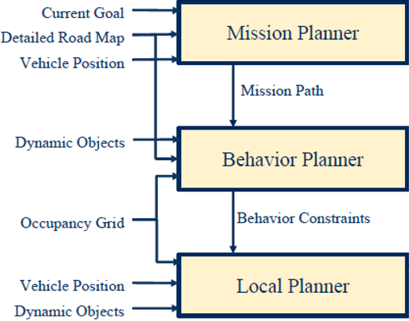
A Hierarchy of Planners
Mission Planning: map-level navigation
Behavior Planning: choosing a behavior based on environmental conditions
Motion Planning: generating a reference trajectory (path + speed profile) to be tracked by controller
Reference Trajectory
Controller (PID, MPC…)

Slide 3
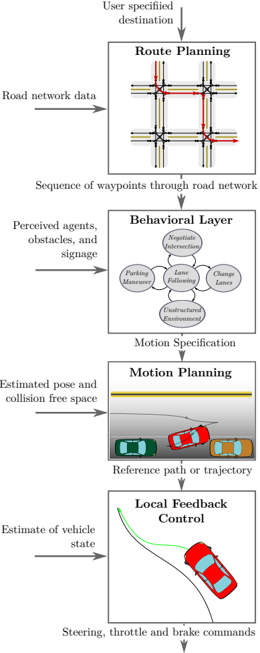
Outline
Route planning
Behavior planning
Motion Planning
Responsibility-Sensitive Safety (RSS)
Paden B, Čáp M, Yong S Z, et al. A survey of motion planning and control techniques for self-driving urban vehicles[J]. IEEE Transactions on intelligent vehicles, 2016, 1(1): 33-55.
3

Slide 4
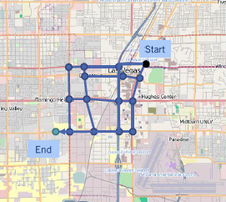
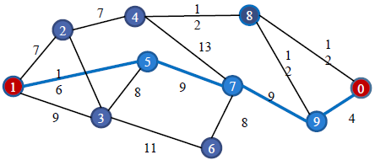
Route Planning
Find the optimal path for navigation from Start to Goal on a weighted graph
Graph search algorithms
Non-informed: BFS, DFS, Dijkstra’s
Informed: A*

Slide 5
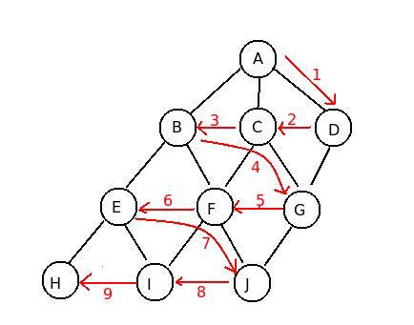
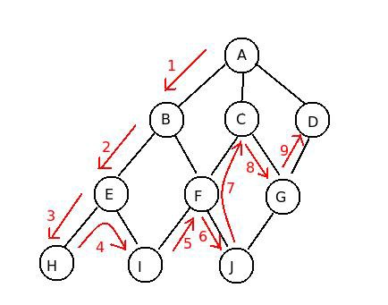
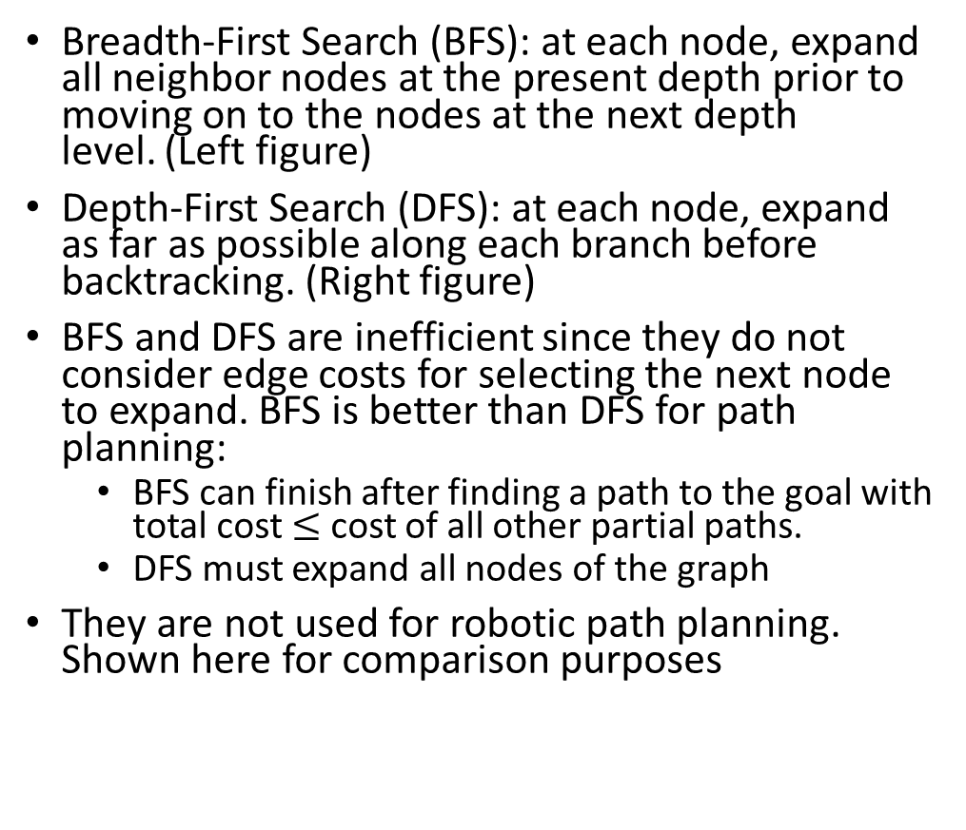
BFS and DFS
Breadth-First Search (BFS): at each node, expand all neighbor nodes at the present depth prior to moving on to the nodes at the next depth level. (Left figure)
Depth-First Search (DFS): at each node, expand as far as possible along each branch before backtracking. (Right figure)
BFS and DFS are inefficient since they do not consider edge costs for selecting the next node to expand. BFS is better than DFS for path planning:
BFS can finish after finding a path to the goal with total cost $≤$ cost of all other partial paths.
DFS must expand all nodes of the graph
They are not used for robotic path planning. Shown here for comparison purposes
BFS
DFS
Notes:
https://qiao.github.io/PathFinding.js/visual/

